Slide 1
Data Structures and Algorithms Design
Febin.A.Vahab
2019-20

Slide 2
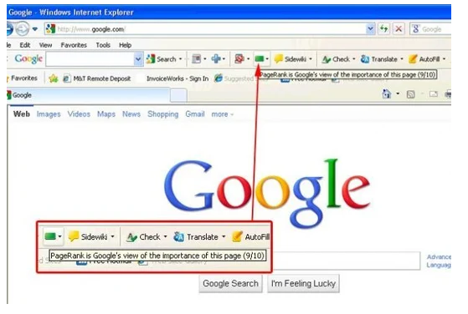

Slide 3
Motivation and Introduction
Step back in time ten years, and PageRank was the SEO metric that everyone talked about..
Fast forward to 2020, and PageRank is rarely mentioned.
But that is not because it is no longer important, just that it is no longer a public-facing metric.
And when SEOs can no longer measure something, they eventually stop talking about it.

Slide 4
Motivation and Introduction
The original PageRank patent from 1998 expired in 2018 and, to the surprise of many, wasn't renewed.
But that doesn't mean PageRank is dead, far from it.
Google updated the new patent regarding the PageRank.
And Yes!!! PageRank is still used in google search algorithms
What is PageRank?
A method for rating the importance of web pages objectively and mechanically using the link structure of the web.

Slide 5
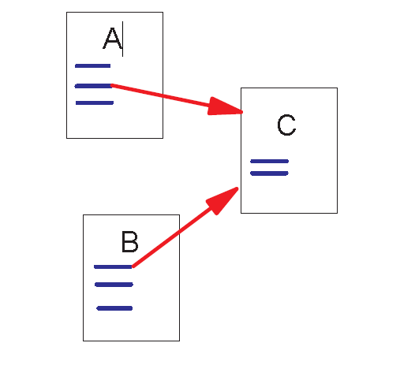
Link Structure of the Web
Backlinks and Forward links:
A and B are C’s backlinks
C is A and B’s forward link

Slide 6
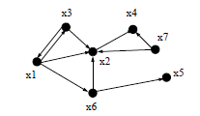
Link Structure of the Web
The hyperlink structure of the World Wide Web can be described as a digraph
The vertices are the web pages with a directed edge from vertex x to vertex y if x has a link to y.

Slide 7
Intuitive Justification-Random Surfer Model
PageRank can be thought of as a model of user behaviour.
We assume there is a "random surfer" who is given a web page at random and keeps clicking on links, never hitting "back" but eventually gets bored and starts on another random page. The probability that the random surfer visits a page is its PageRank.
The probability for the random surfer reaching one page is the sum of probabilities for the random surfer following links to this page
Intuitively, a webpage is important if it has a lot of backlinks

Slide 8

Random Walk on the Web graph
Sergey and Larry decided to model a user’s web experience as following each link on a page with uniform probability
For example, if the user is at page x, and there are three links from page x, then each link is followed with probability 1/3. More generally, they assigned each edge x $→$ y of the web graph with a probability conditioned on being on page x:
Pr [follow link x $→$ y at page x]= $\frac{1}{outdeg(x)}$

Slide 9

Random Walk on the Web graph
$$\operatorname{Pr}\left[go to y\right]=\sum_{edges x→y}{\operatorname{Pr}\left[follow link x→y at Page x\right].Pr⁡[at page x]}$$
=$\sum_{edges x→y}{\frac{Pr[at x]}{outdeg(x)}}$
Example
$Pr\left[go to x4\right]=\frac{Pr[at x7]}{2}$ + $\frac{Pr[at x2]}{1}$

Slide 10
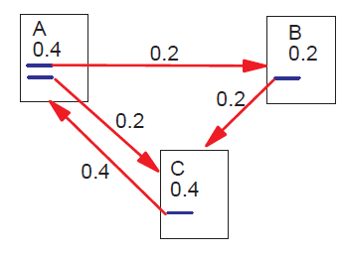
Page rank calculation
A link to a page counts as a vote of support.

Slide 11
Intuitive Justification
Another intuitive justification is that a page can have a high PageRank if there are many pages that point to it, or if there are some pages that point to it and have a high PageRank.
Intuitively, pages that are well cited from many places around the web are worth looking at. Also, pages that have perhaps only one citation from something like the NASA homepage are also generally worth looking at.
If a page was not high quality, or was a broken link, it is quite likely that NASA homepage would not link to it.
PageRank handles both these cases and everything in between by recursively propagating weights through the link structure of the web.

Slide 12
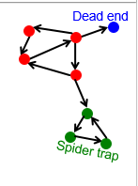
Page rank calculation-2 Problems
2 problems:
(1) Some pages are dead ends (have no out-links)
Random walker has “nowhere” to go to
Such pages cause importance to “leak out”
(2) Spider traps: (all out-links are within the group)
Random walker gets “stuck” in a trap
And eventually spider traps absorb all importance

Slide 13
Page rank calculation
To model this aspect of the web, Sergey and Larry added a supervertex to the web graph and added an edge from every page to the supervertex.
Moreover, the supervertex points to every other vertex in the graph with equal probability, allowing the walk to restart from a random place.

Slide 14
Page rank calculation

Slide 15
Page rank calculation
This ensures that the graph is strongly connected.
If a page had no hyperlinks, then its edge to the supervertex has to be assigned probability one.
For pages that had some hyperlinks, the additional edge pointing to the supervertex was assigned some specially given probability.
In the original versions of Page Rank, this probability was arbitrarily set to 0.15. That is, each vertex with outdegree n>= 1 got an additional edge pointing to the supervertex with assigned probability 0.15
Its other n outgoing edges were still kept equally likely, that is, each of the n edges was assigned probability 0.85/n

Slide 16
Page rank calculation
Quoting from the original Google paper, PageRank is defined like this:
We assume page A has pages T1...Tn which point to it (i.e., are citations). The parameter d is a damping factor which can be set between 0 and 1. We usually set d to 0.85. Also C(A) is defined as the number of links going out of page A. The PageRank of a page A is given as follows:
PR(A) = (1-d) + d (PR(T1)/C(T1) + ... + PR(Tn)/C(Tn))
Note that the PageRanks form a probability distribution over web pages, so the (normalised)sum of all web pages' PageRanks will be one.

Slide 17
Page rank calculation
PR(A) = (1-d) + d (PR(T1)/C(T1) + ... + PR(Tn)/C(Tn))
PR(Tn) - Each page has a notion of its own self-importance. That’s “PR(T1)” for the first page in the web all the way up to “PR(Tn)” for the last page
C(Tn) - Each page spreads its vote out evenly amongst all of it’s outgoing links. The count, or number, of outgoing links for page 1 is “C(T1)”, “C(Tn)” for page n, and so on for all pages.
PR(Tn)/C(Tn) - so if our page (page A) has a backlink from page “n” the share of the vote page A will get is “PR(Tn)/C(Tn)”

Slide 18

Page rank calculation
d - All these fractions of votes are added together but, to stop the other pages having too much influence, this total vote is “damped down” by multiplying it by 0.85 (the factor “d”)
Intuitive Explanation: d damping factor is the probability at each page the "random surfer" will continue clicking the links.
(1 - d) - The (1 – d) bit at the beginning is a bit of probability math magic so the “sum of all web pages' PageRanks will be one”: it adds in the bit lost by the d (.... It also means that if a page has no links to it (no backlinks) even then it will still get a small PR of 0.15 (i.e. 1 – 0.85). (Aside: the Google paper says “the sum of all pages” but they mean the “the normalised sum” )

Slide 19
Page rank calculation
The equation is recursive
But it can be computed starting with any set of ranks and iterating the computation till it converges.
The PageRanks then forms a probability distribution over web pages, so the(normalized) sum of all pages' PageRanks will be one

Slide 20
Page rank calculation: Intuitive Explanation
Page A has a certain amount of link value (PageRank) by virtue of links pointing to it. When page A then links to page B, page B gets a dose of the link value that page A has.
The PageRank that page B gets from page A needs to be less than 100% of page A’s PageRank.
This is called the PageRank Damping Factor.(0.85)
PageRank of page A is multiplied by 0.85 to give the PageRank of page B.
Thus, page B gets 85% of the PageRank of page A, and 15% of the PageRank is dissolved
The PageRank of page B (85% of page A’s PageRank) is multiplied by 0.85, and so page C gets 72.25% of page A’s original PageRank.
Page A
Page B
Page C

Slide 21
Page rank calculation
This is where it gets tricky.
The PR of each page depends on the PR of the pages pointing to it.
But we won’t know what PR those pages have until the pages pointing to them have their PR calculated and so on…
And when you consider that page links can form circles it seems impossible to do this calculation
Is it???

Slide 22
Page rank calculation
We can calculate a page’s PR without knowing the final value of the PR of the other pages
That seems strange but, basically, each time we run the calculation we’re getting a closer estimate of the final value.
So all we need to do is remember each value we calculate and repeat the calculations lots of times until the numbers stop changing much.

Slide 23
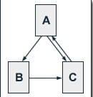
Page rank calculation
We consider a small web consisting of three pages A, B and C, whereby page A links to the pages B and C, page B links to page C and page C links to page A. the damping factor d is usually set to 0.85
PR(A)=(1-d)+d(PR(T1)/C(T1)+ ... + PR(Tn)/C(Tn))
PR(A) = (1-d) +d(PR(C)/1)=0.15+0.85(1)=1
PR(B) = 0.15 + 0.85 (PR(A) / 2)=0.575
PR(C) = 0.15 + 0.85 (PR(A) / 2 + PR(B)/1)=1.064

Slide 24
PR(A) | PR(B) | PR( C )
1 | 0.575 | 1.06375
1.0541875 | 0.59803 | 1.106355
1.090401684 | 0.613421 | 1.134828
1.114604075 | 0.623707 | 1.153857
1.130778836 | 0.630581 | 1.166575
1.141588631 | 0.635175 | 1.175074
1.148812952 | 0.638246 | 1.180754
1.153641056 | 0.640297 | 1.18455
1.156867738 | 0.641669 | 1.187087
1.15902417 | 0.642585 | 1.188783
1.160465341 | 0.643198 | 1.189916
1.161428493 | 0.643607 | 1.190673
1.16207218 | 0.643881 | 1.191179
1.162502364 | 0.644064 | 1.191517
1.162789861 | 0.644186 | 1.191744
1.162981999 | 0.644267 | 1.191895
1.163110407 | 0.644322 | 1.191996
1.163196224 | 0.644358 | 1.192063
1.163253576 | 0.644383 | 1.192108
1.163291906 | 0.644399 | 1.192138
1.163317522 | 0.64441 | 1.192158
1.163334641 | 0.644417 | 1.192172
1.163346082 | 0.644422 | 1.192181
1.163353729 | 0.644425 | 1.192187
1.163358839 | 0.644428 | 1.192191
1.163362254 | 0.644429 | 1.192194
1.163364536 | 0.64443 | 1.192195
1.163366062 | 0.644431 | 1.192197
Page rank calculation
We get the following Page rank values for the single pages:
PR(A) = 1.634
PR(B) = 0.644
PR(C) = 1.192
The sum of all pages' PageRanks is 3 and thus equals the total number of web pages. Normalised sum will be equal to 1

Slide 25
Page rank calculation
It doesn’t matter where you start your guess, once the PageRank calculations have settled down, the “normalized probability distribution” (the average PageRank for all pages) will be 1.0
We get a good approximation of the real PageRank values after only a few iterations. According to publications of Lawrence Page and Sergey Brin, about 100 iterations are necessary to get a good approximation of the PageRank values of the whole web.

Slide 26
Page Rank
A page will be included in the Google index only if one or more pages on the web link to it[Is it??]. That’s according to Google. If a page is not in the Google index, any links from it can’t be included in the calculations.
The site’s maximum PageRank is the amount of PageRank in the site. In this case, we have 3 pages so the site’s maximum is 3.
No matter how many iterations you run, each page’s PageRank remains at 0.15.
The total PageRank in the site = 0.45, whereas it could be 3.
The site is seriously wasting most of its potential PageRank.
A
B
C
PR(A)=(1-d)+d(PR(T1)/C(T1)+ ... + PR(Tn)/C(Tn))

Slide 27
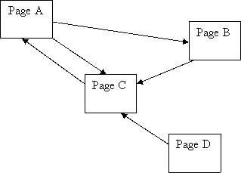
Page rank calculation-Example 1

Slide 28
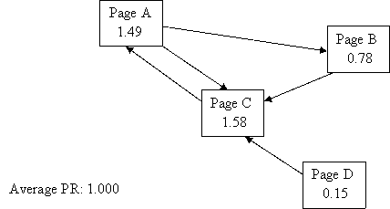
Page rank calculation-Example 1
Look at Page D though, it has a PR of 0.15 even though no-one is voting for it (i.e. it has no incoming links)! Is this right?
The first part of the PR equation is doing this:
PR(A) = (1-d) + d (PR(T1)/C(T1) + ... + PR(Tn)/C(Tn))
So for Page D, no backlinks means the equation looks like this:
PR(A) = (1-d) + d * (0) = 0.15

Slide 29
Page rank calculation-Example 1
Observation: every page has at least a PR of 0.15 to share out.
But this may only be in theory - there are rumours that Google undergoes a post-spidering phase whereby any pages that have no incoming links at all are completely deleted from the index..

Slide 30
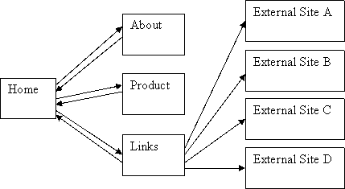
Page rank calculation-Example 2

Slide 31
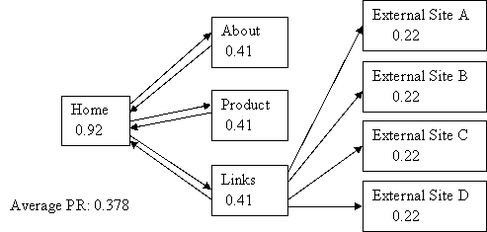
Page rank calculation-Example 2
The home page has the most PR – after all, it has the most incoming links.
Take a look at the “external site” pages – what’s happening to their PageRank?
They’re not passing it on, they’re not voting for anyone, they’re wasting their PR

Slide 32
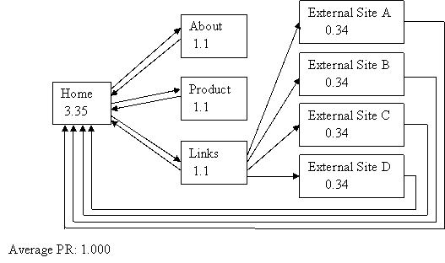
Page rank calculation-Example 3

Slide 33
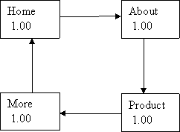
Page rank calculation-Example 4
All the pages have the same number of incoming links, all pages are of equal importance to each other, all pages get the same PR of 1.0

Slide 34
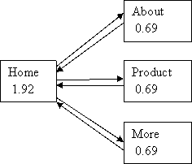
Page rank calculation-Example 5
A Simple Hierarchy
Our home page has 2 and a half times as much PR as the child pages! Excellent!
Observation: a hierarchy concentrates votes and PR into one page

Slide 35
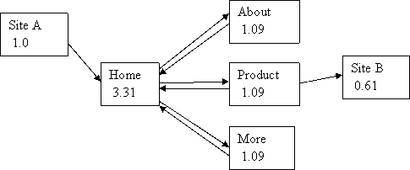
Page rank calculation-Example 5-Hierarchical but with a link in and out
In previous example the home page only had a PR of 1.92 but now it is 3.31! Excellent! Not only has site A contributed 0.85 PR to home, but raised PR in the “About”, “Product” and “More” pages( has had a lovely “feedback” effect), pushing up the home page’s PR even further!

Slide 36
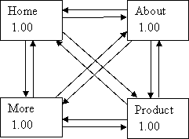
Page rank calculation-Example 6-Fully Meshed

Slide 37
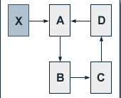
HW:Discuss in Canvas
The Influence of the Damping Factor
The degree of PageRank propagation from one page to another by a link is primarily determined by the damping factor d.
Compare the effect of d=0.85 and d=0.75 on the below web.

Slide 38
Page rank calculation-Take away
From Brin and Page paper, the average Actual PR of all pages in the index is 1.0!
So if you add pages to a site you’re building the total PR go up by 1.0 for each page (but only if you link the pages together so the equation can work), but the average will remain the same.
If you want to concentrate the PR into one, or a few, pages then hierarchical linking will do that.
If you want to average out the PR amongst the pages then "fully meshing" the site (lots of evenly distributed links) will do that

Slide 39
Page rank calculation-Take away
Getting inbound links to your site is one way to increase your site's average PR
If you give outbound links to other sites then your site's average PR will decrease (you're not keeping your vote "in house" as it were). Again the details of the decrease will depend on the details of the linking.
If your page usually links to other pages ,these pages get a PageRank benefit also. If these pages link back to page A, page A will have an even higher PageRank benefit from its additional inbound link.

Slide 40
Page rank calculation-Take away
PageRank is, in fact, very simple
But when a simple calculation is applied hundreds (or billions) of times over the results, it can seem complicated.
PageRank is also only part of the story about what results get displayed high up in a Google listing. For example Google is paying a lot of attention these days to the text in a link’s anchor when deciding the relevance of a target page – perhaps more so than the page’s PR…
PageRank is still part of the listings story though, so it’s worth you understand it “correctly”.☺

Slide 41
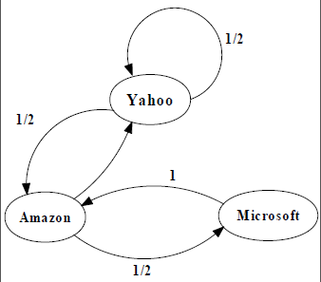
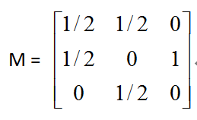
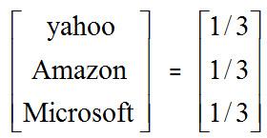
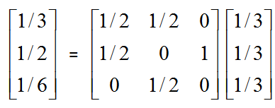
An Example for Analysis
PageRank Calculation: first iteration

Slide 42
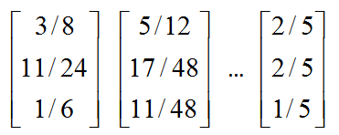
An Example for Analysis
Convergence after some iterations

Slide 43
HW:Discuss in Canvas
Calculate the page ranks
A
B
A
B
C
C
A
B
A
B
C
C

Slide 44
Page Rank-References
The PageRank Citation Ranking: Bringing Order to the Web. Page, Lawrence and Brin, Sergey and Motwani, Rajeev and Winograd, Terry (1999) The PageRank Citation Ranking: Bringing Order to the Web. Technical Report. Stanford InfoLab.
The Anatomy of a Large-Scale Hypertextual Web Search Engine Brin, S. and Page, L. (1998) The Anatomy of a Large-Scale Hypertextual Web Search Engine. In: Seventh International World-Wide Web Conference (WWW 1998), April 14-18, 1998, Brisbane, Australia.

Slide 45
Thank You!!! ☺

